Slide 1
How to load GIFs
<!-- <span> <img src="/progress_pics/playerAttackTest2.gif" width="300" height="300" style="display:inline-block; vertical-align: middle;" /> </span> -->

Slide 2
ReadMe
Includes figures displaying progress
Backgrounds
Player Sprites
Enemy Sprites
Boss Sprites

Slide 3
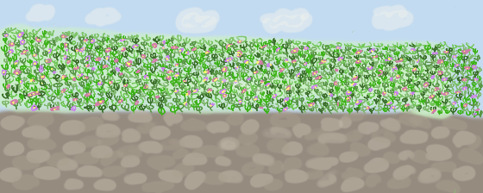
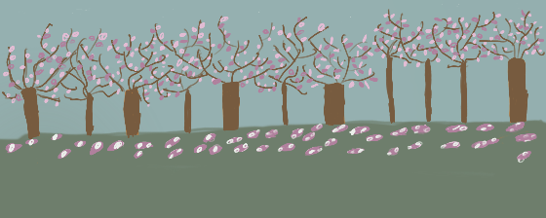

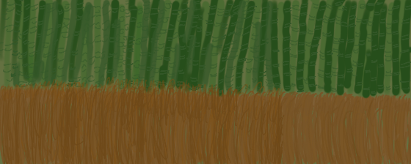
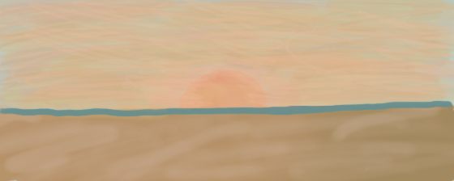
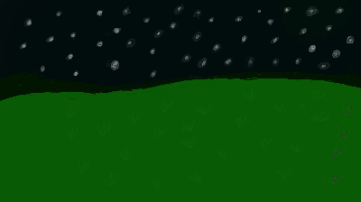
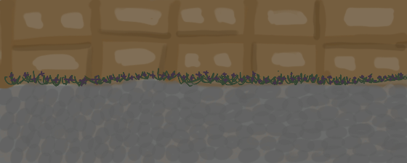
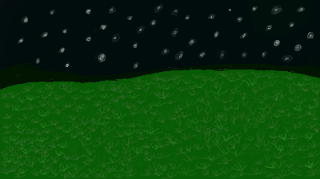
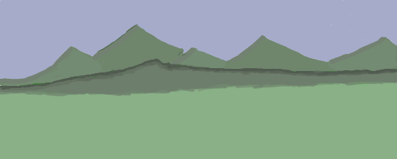

Slide 4
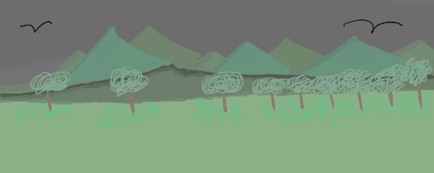
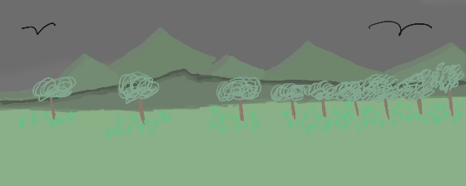
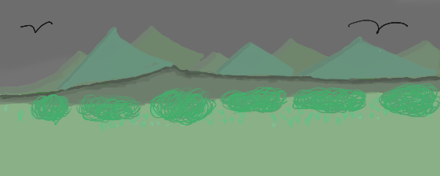
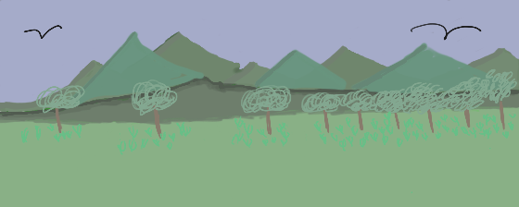
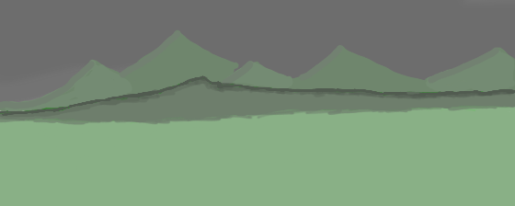
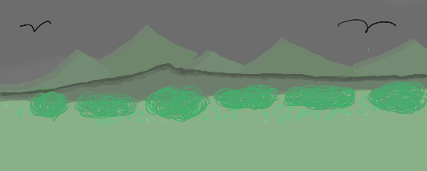
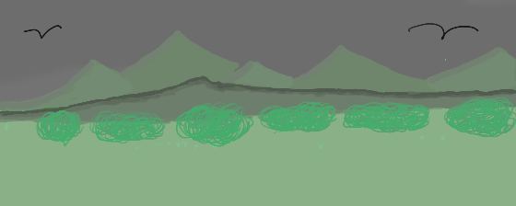
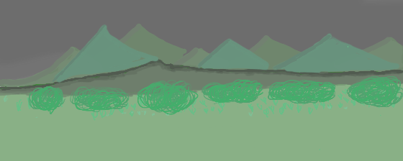
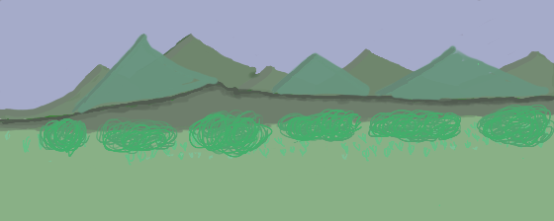
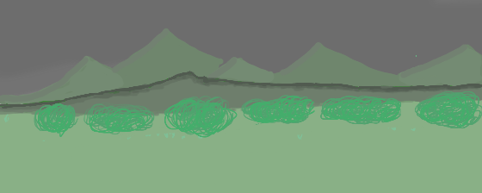
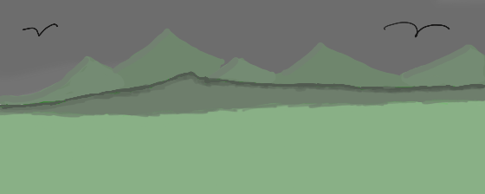


Slide 5
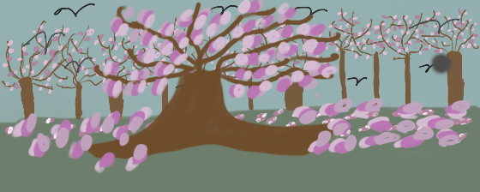
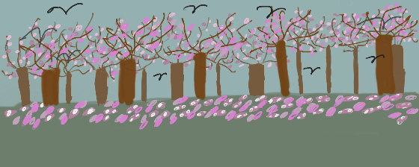
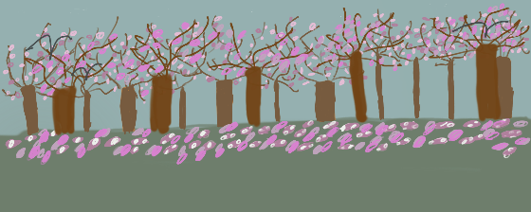
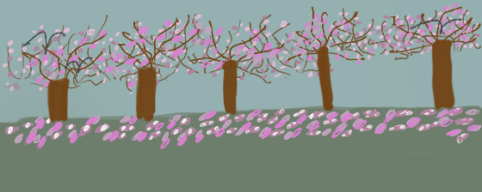
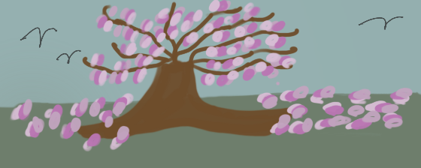
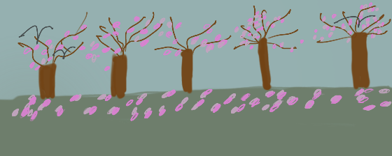
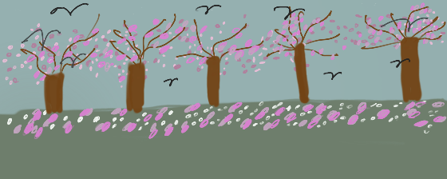
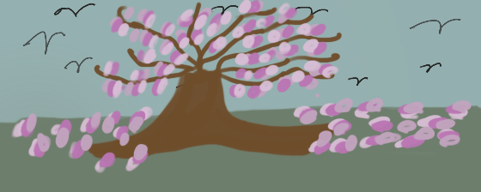
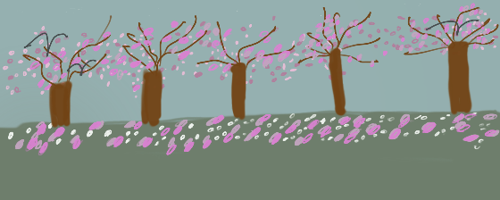

Slide 6

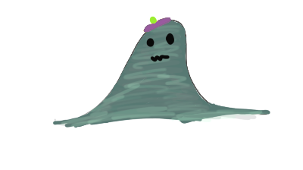

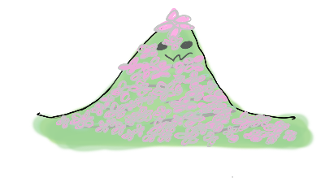

Slide 7
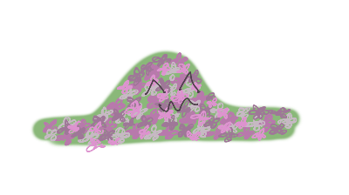
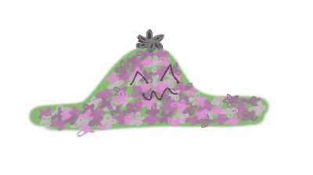

Slide 8



Option 1
Option 2
Option 3

Slide 9


Slide 10
PLAYER

Slide 11
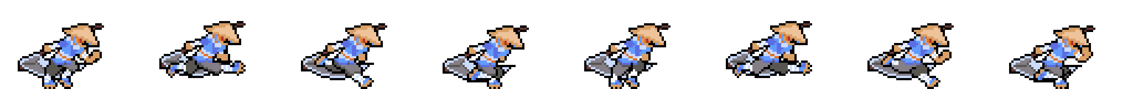


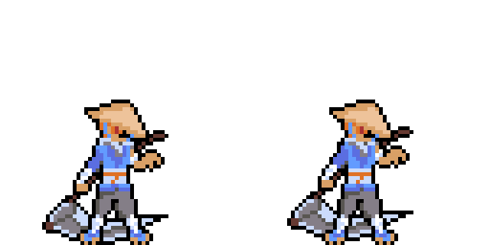

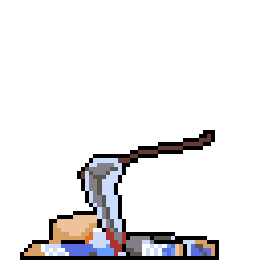
Running
Jump
Land
Idle
Hurt
Dead

Slide 12
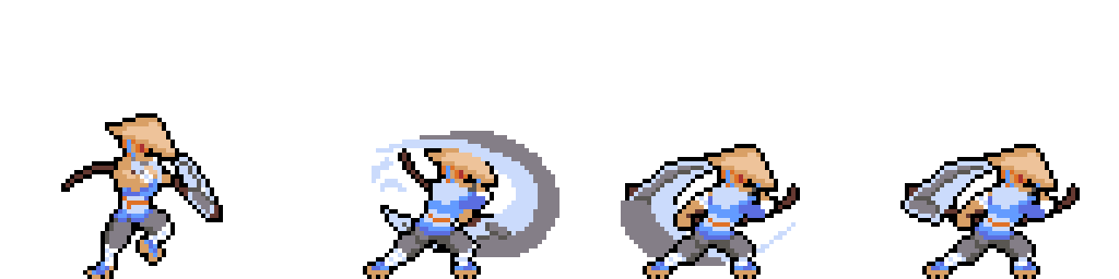
Attack

Slide 13
Notes:
Player Running

Slide 14
Notes:
Player Land

Slide 15
Notes:
Player Jump

Slide 16
Notes:
Player Idle

Slide 17
Notes:
Player Hurt

Slide 18
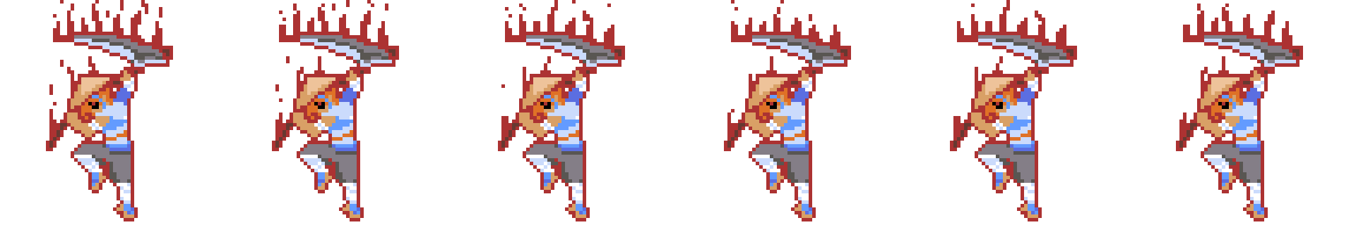

Flow State Activate
Flow State

Slide 19
Notes:
Player Flow

Slide 20
Notes:
Player Flow State Activate

Slide 21
Notes:
Player Dead

Slide 22
Notes:
Player Attack

Slide 23
Enemy

Slide 24
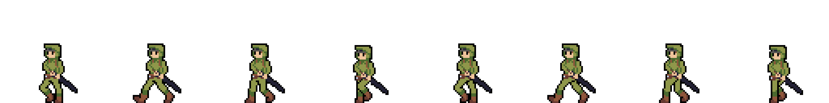
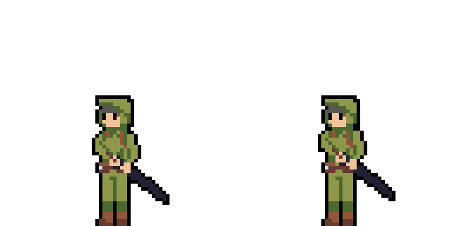
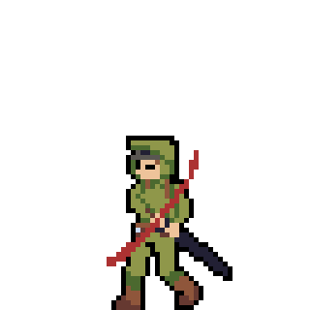

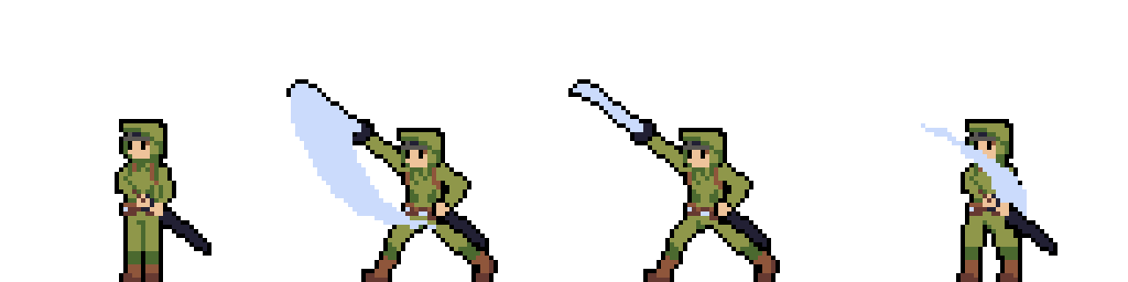
Walking
Idle
Hurt
Dead
Attack

Slide 25
Notes:
Enemy Walk

Slide 26
Notes:
Enemy idle

Slide 27
Notes:
Enemy hurt

Slide 28
Notes:
Enemy dead

Slide 29
Notes:
Enemy Atttack

Slide 30



Mountains
Sky
Cherry Blossoms

Slide 31



Fire on Right of Flow Bar
Flow Bar
Flow State Activate

Slide 32
Reap
Kurt Kimura, Amanda Nitta, Lloyd Sanderson
https://ics485-project-reap.github.io/

Slide 33
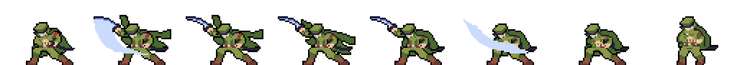
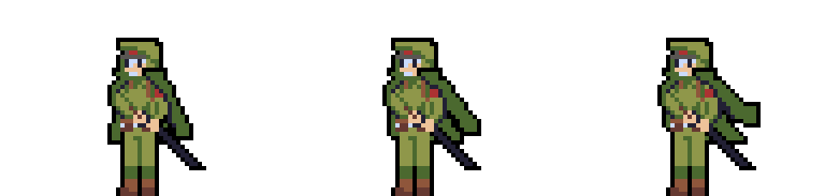
Attack
Idle

